Slide 1

Quantifying the Impact of the Covid-19 Lockdown Measures on Nitrogen Dioxide Levels throughout Europe ¹⁾
Sverre Solberg *, Sam-Erik Walker, Philipp Schneider and Cristina Guerreiro
¹⁾ https://doi.org/10.3390/atmos12020131

Slide 2

Background for work
Originally – trend studies for EEA
«Remove» met. influence on long-term trends
Covid study
A contribution to EEA’s Air Pollution Report 2020
Financed by the EEA/ETC

Slide 3
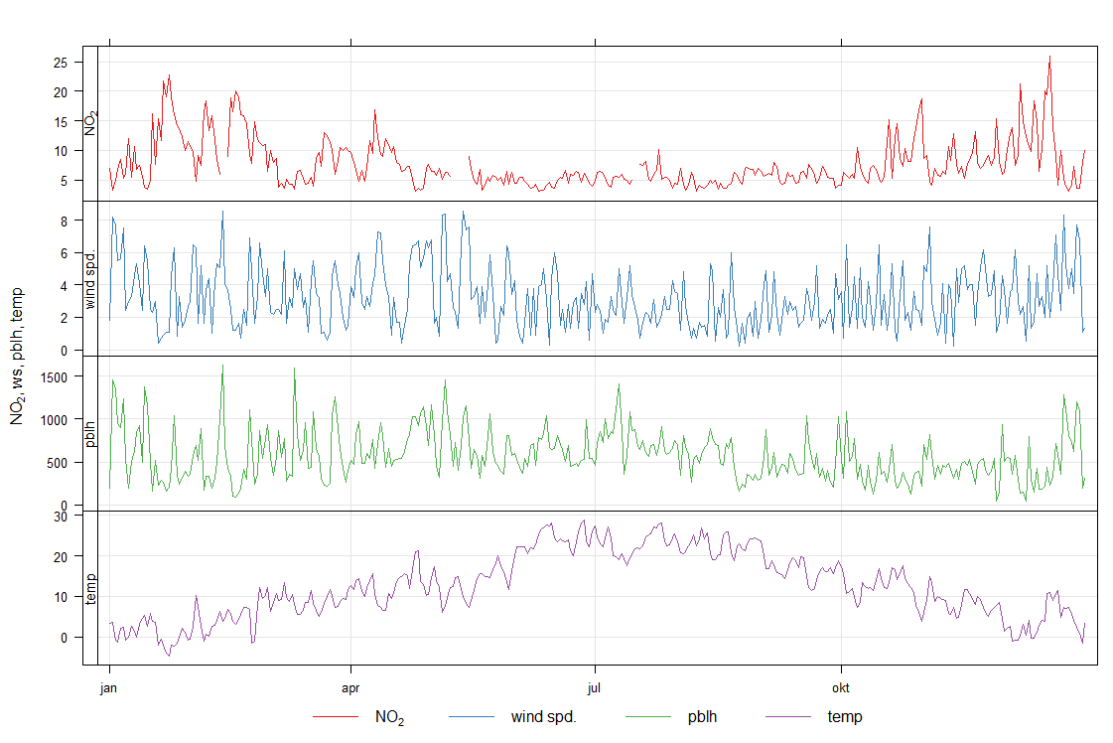
Statistical model: GAM*
Concept: “explain” pollutant levels by met.data and time data
*Generalized Additive Model
Daily mean NO₂ and met at Illmitz 2019

Slide 4
Statistical model: GAM – a non-linear regression model
(Advanced form of multiple linear regression model)
β₀ = intercept
β_{j} = smooth functions of the explanatory variables (T, RH, ws, …)
x_{ij} = value of explanatory variable j at day i
Y_{i} = response variable at day i (= daily mean NO₂)
g(μ_{i}) = link function (for NO₂ we use a log link function g=log(μ))

Slide 5
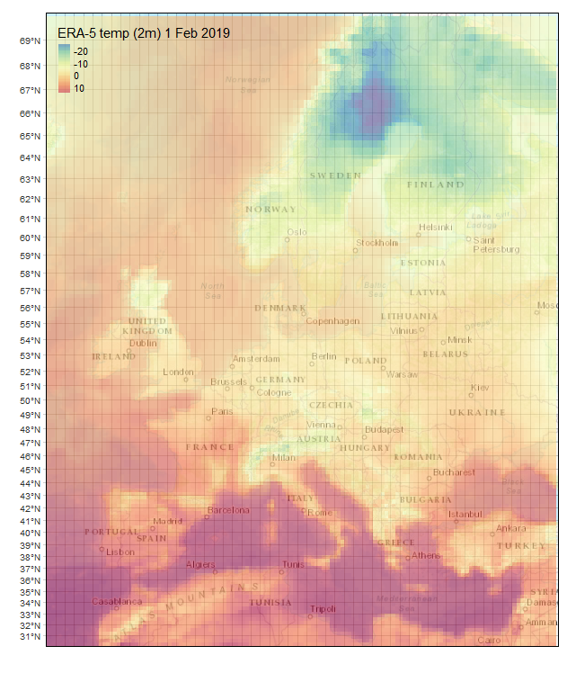
Input met. data for NO₂ GAM modeling of Covid effect
Time series of gridded met. data from ECMWF ERA5 (daily or 6h) at 0.3° x 0.3° at each station of
2m temp
wind at 10 m (ws and wd)
PBL height
RH
(medium cloud cover)*
*Added in a new version

Slide 6
GAM for COVID study
Met. data time series (daily means) combined with time data:
Day of week
Day of year
Trend (day since 01.01.2015)
Time series of NO₂ downloaded from EEA for ~ 2500 stations 2015-2020 (EMEP data only included if reported to EEA)
GAM setup:
First trained on Mar-July 2015-2019 (incl. cross-validation)
Then applied to predict "business-as-usual" for 2020
Statistical uncertainty determined by 100 draws from gamma function every day/each station

Slide 7
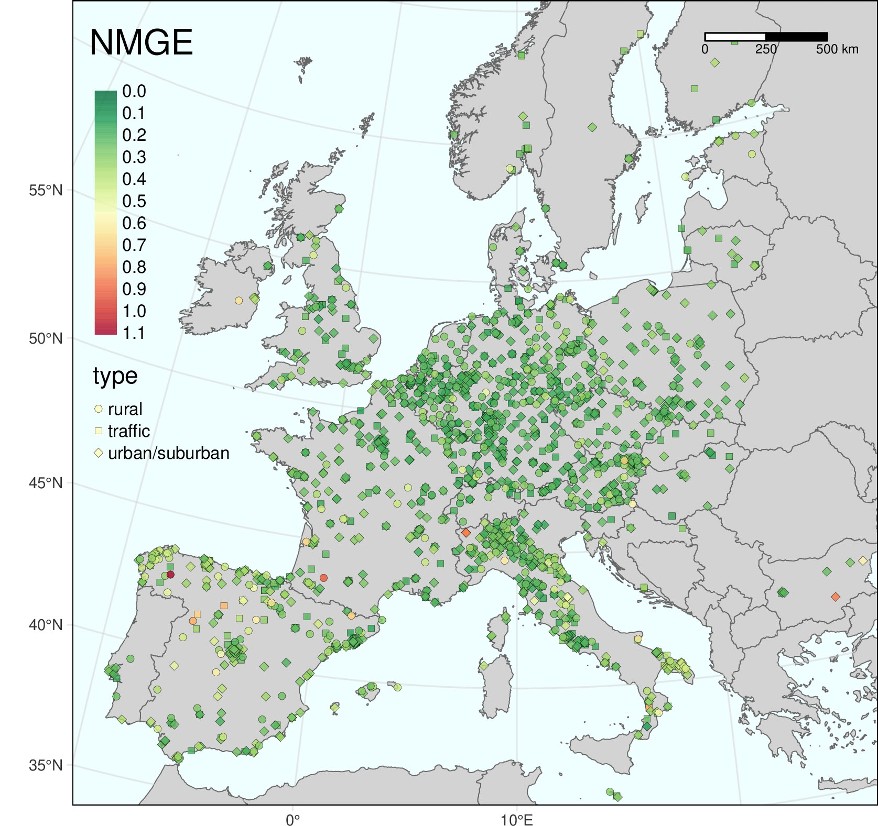
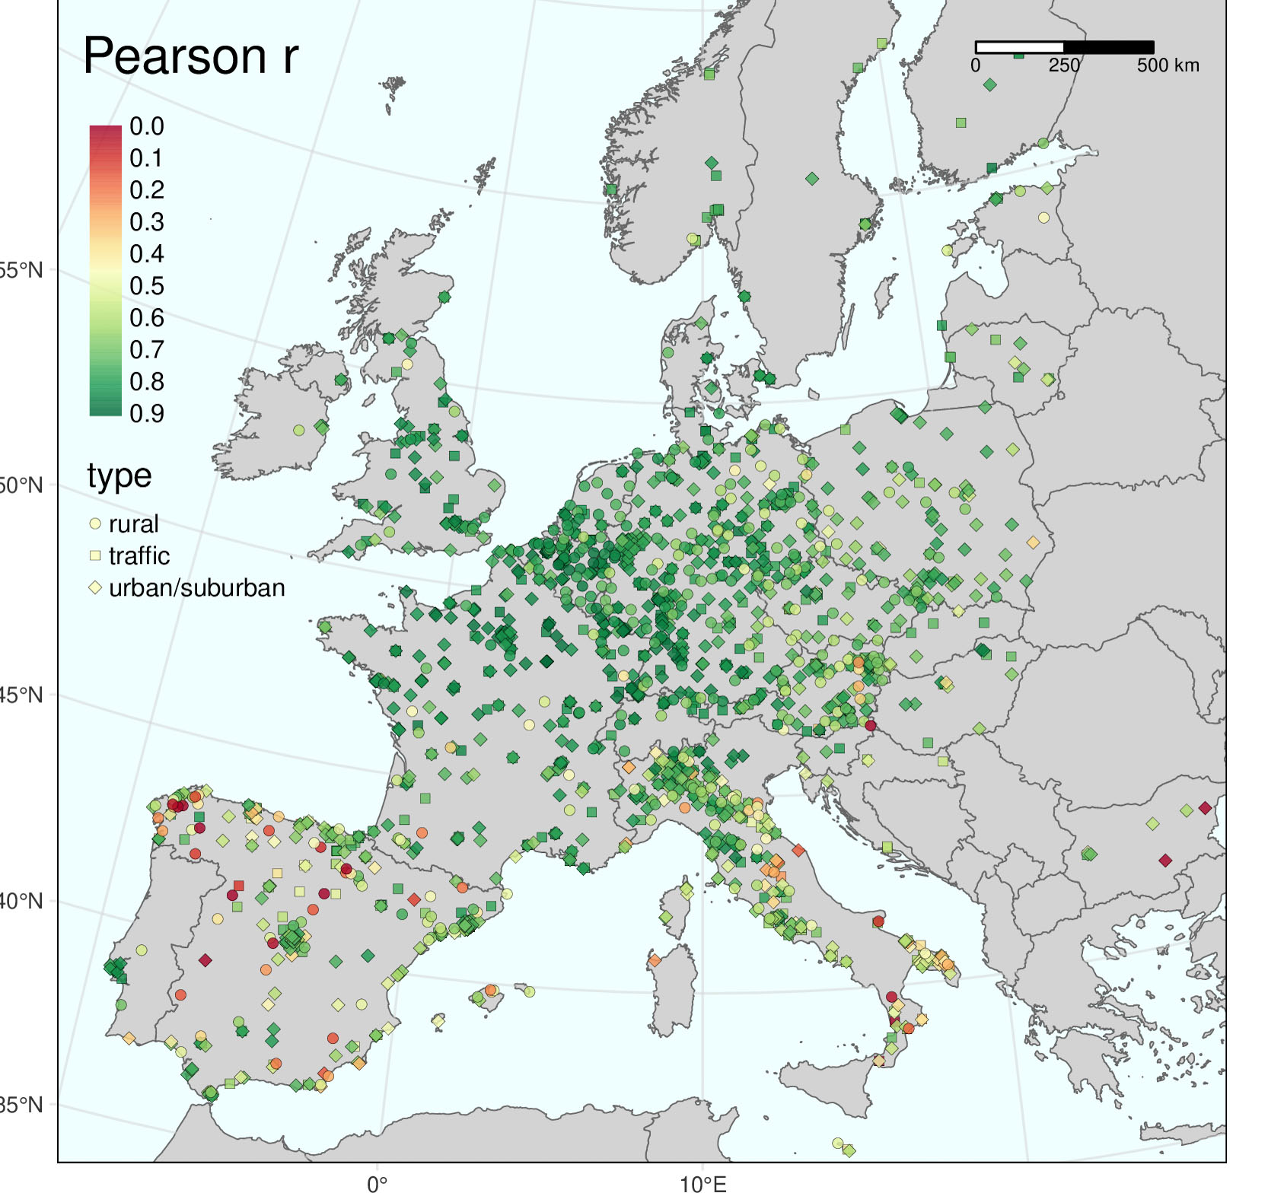
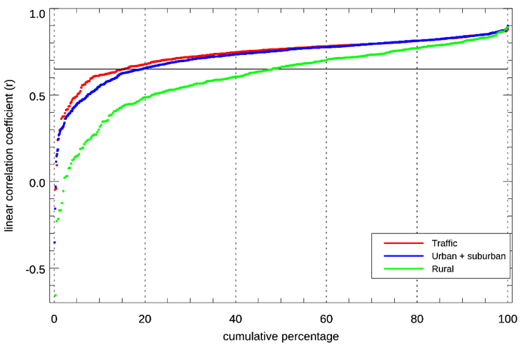
GAM performance
Best performance for traffic/urban/suburban sites
Higher fraction of «failure» in the south (Spain/Italy/Bulgaria)
Errors in measurement data one reason
Data screened on r > 0.65

Slide 8
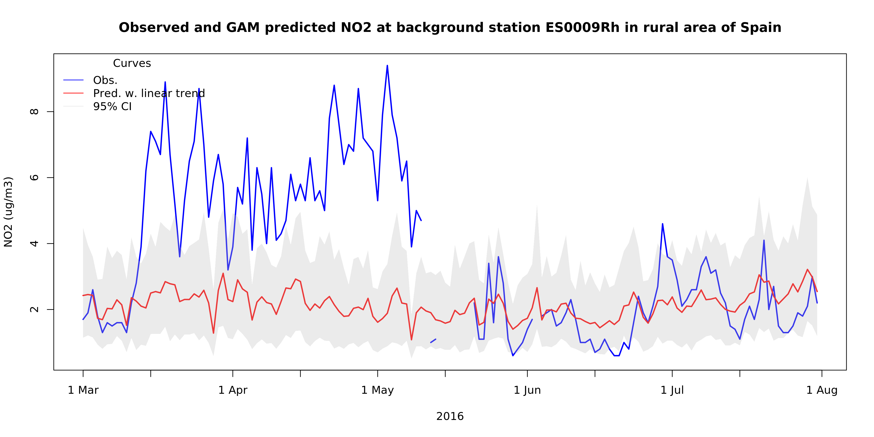
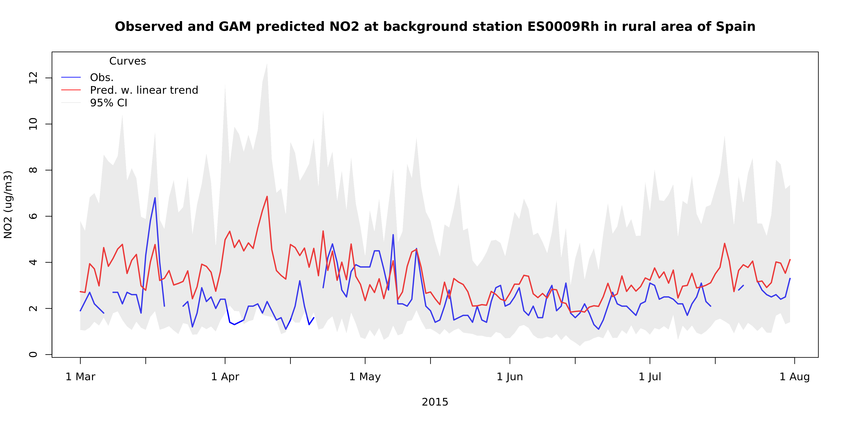
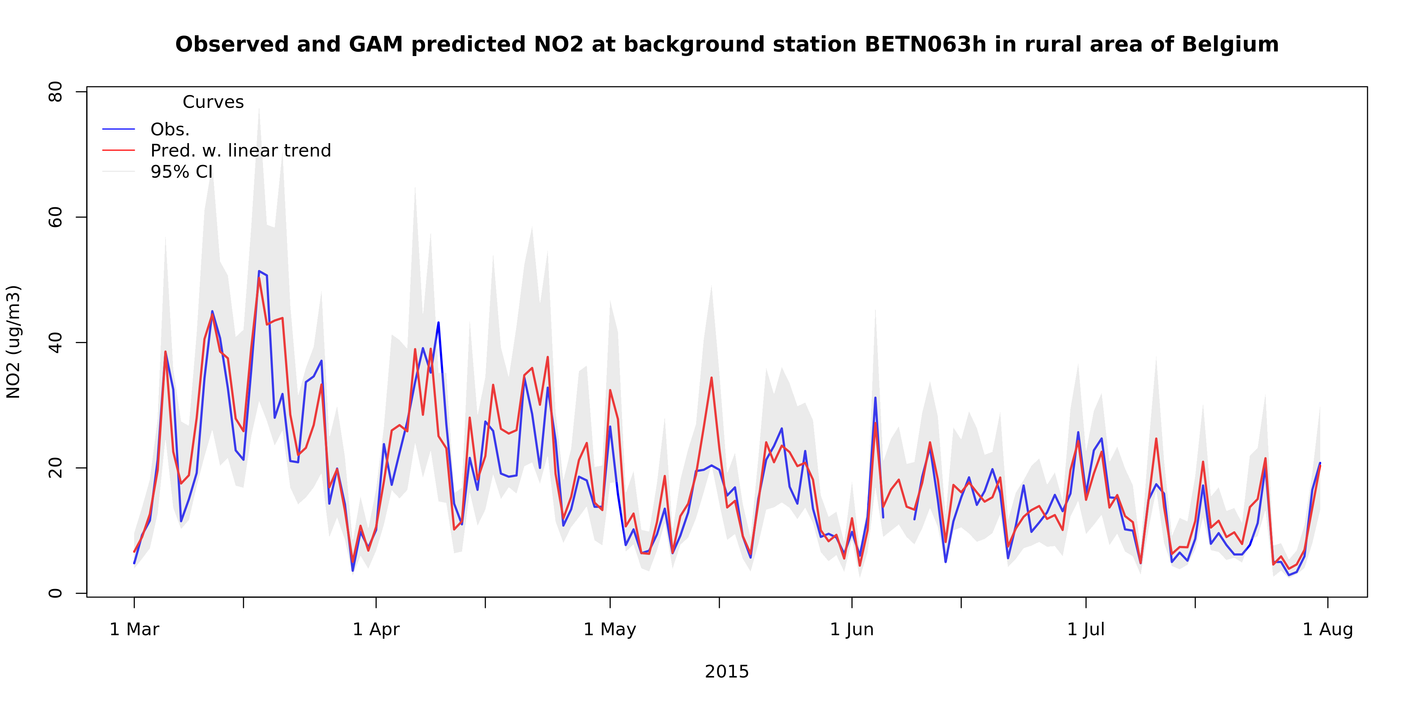
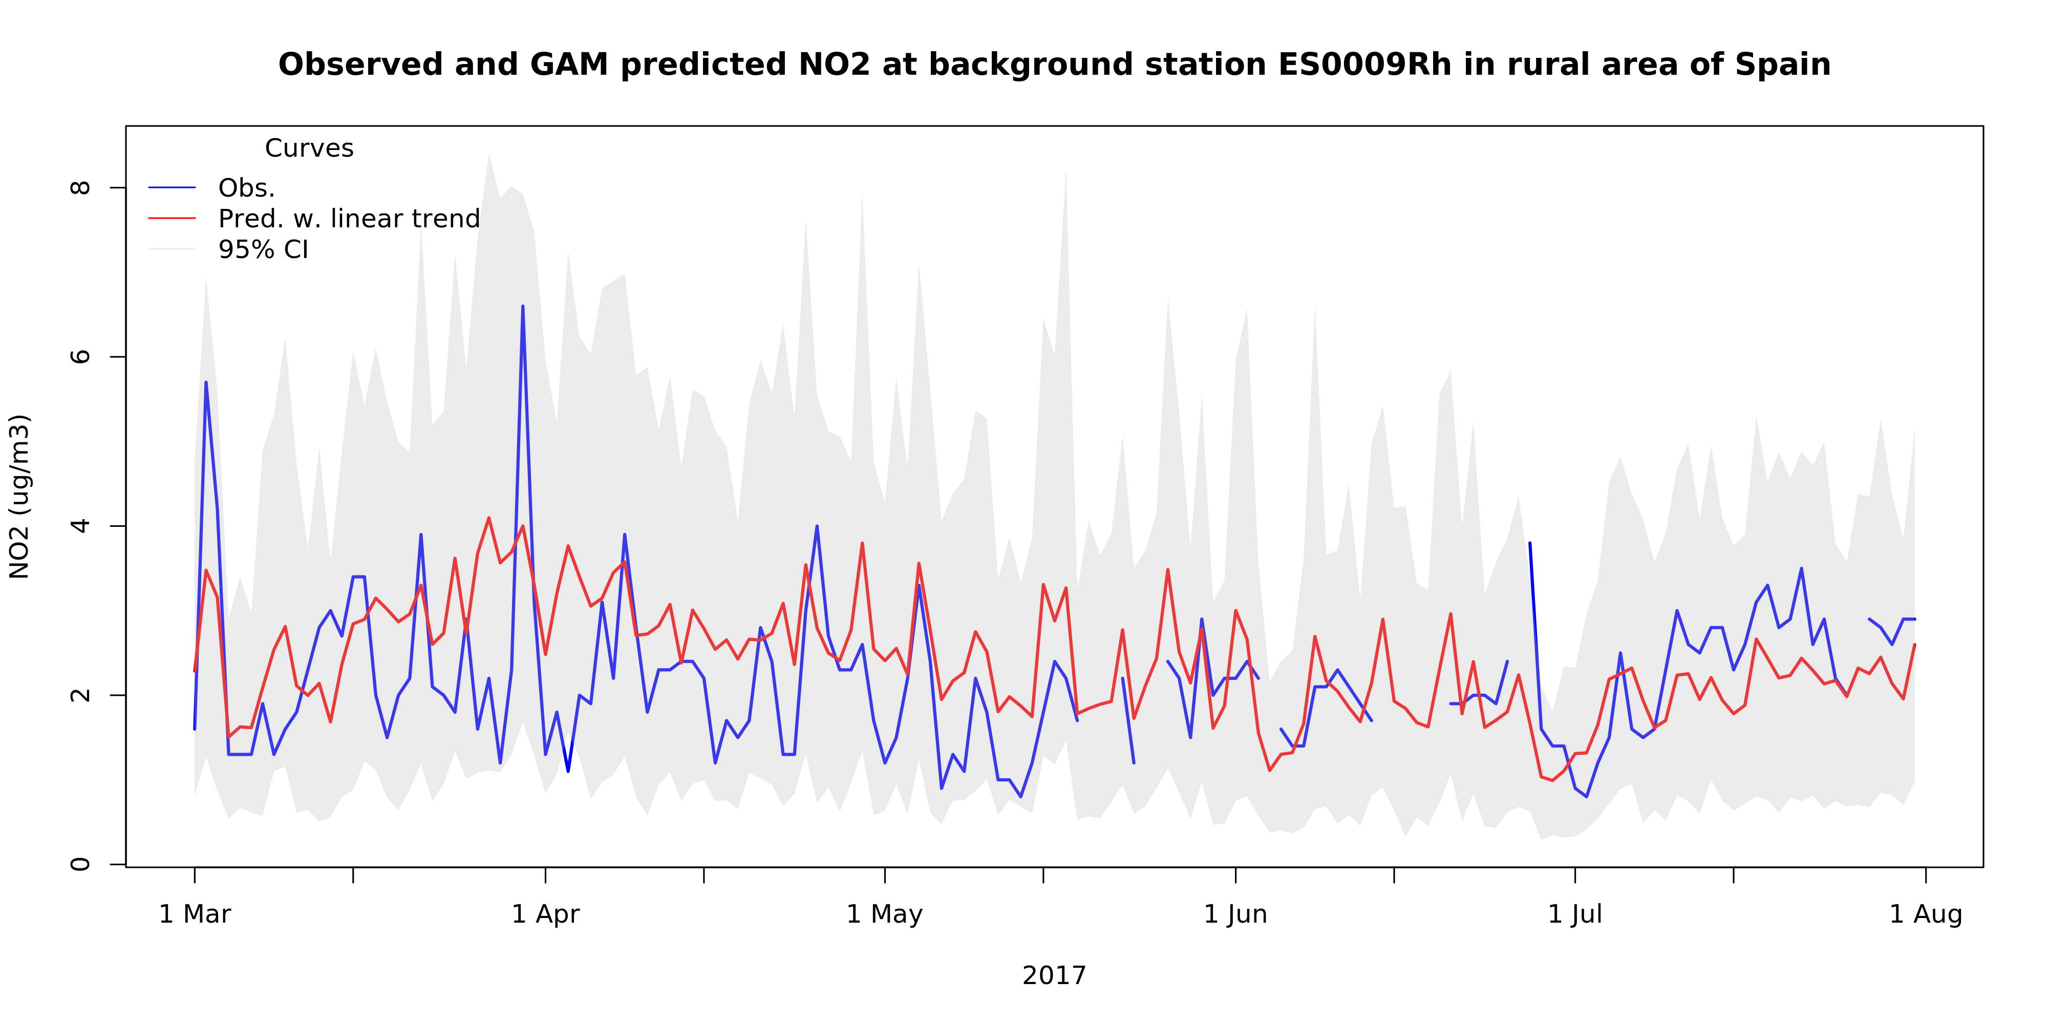
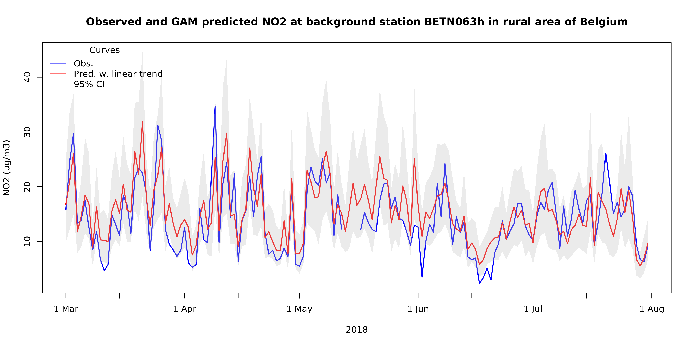
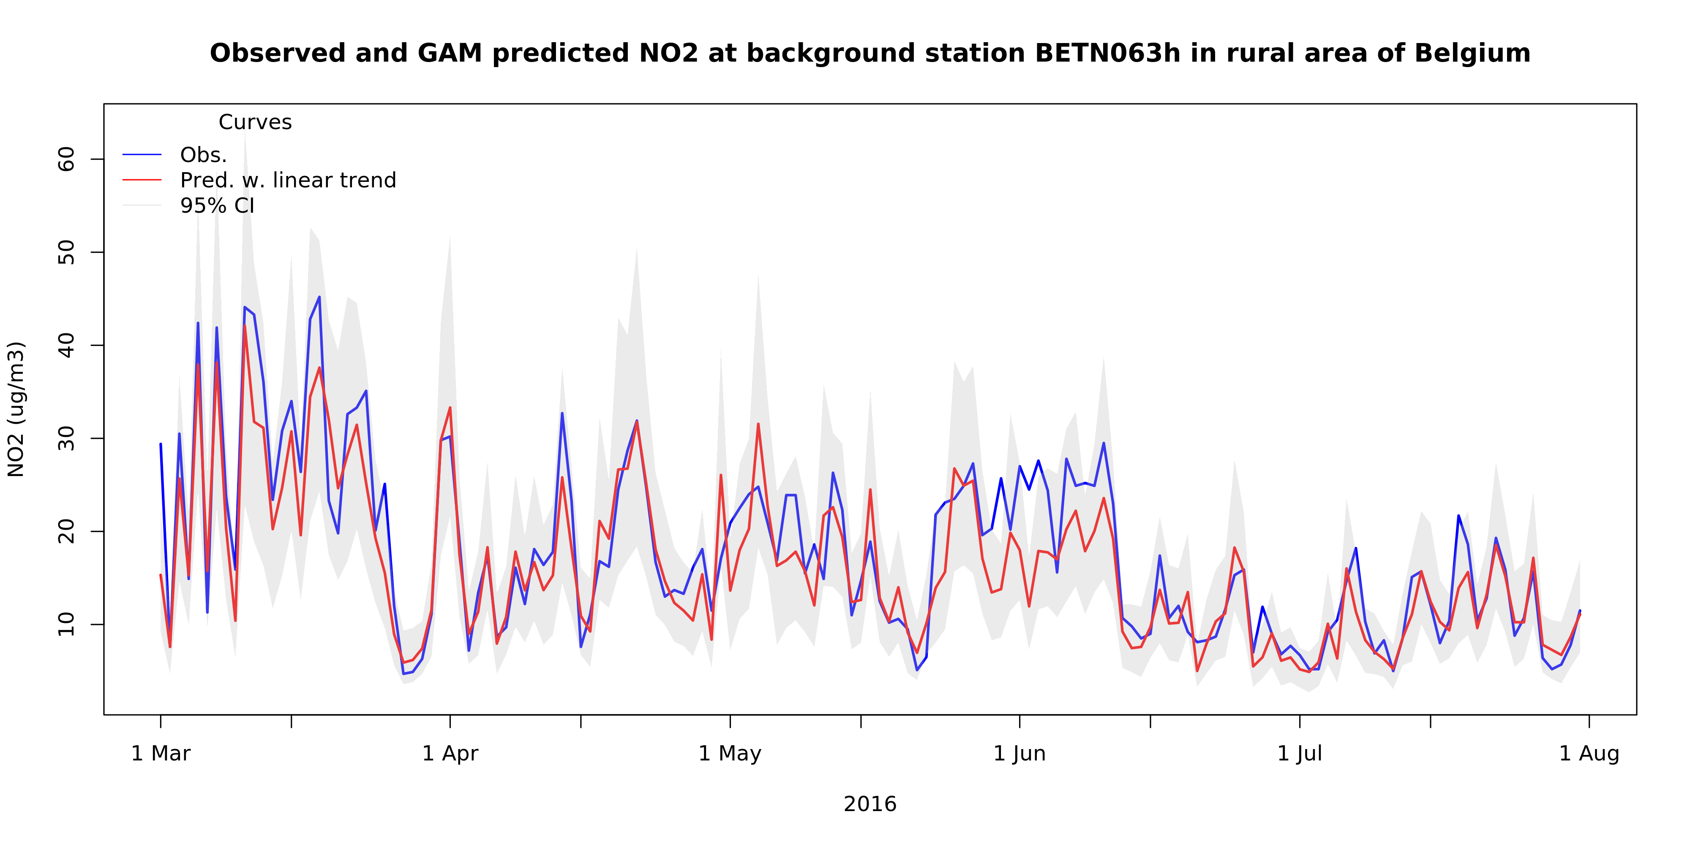
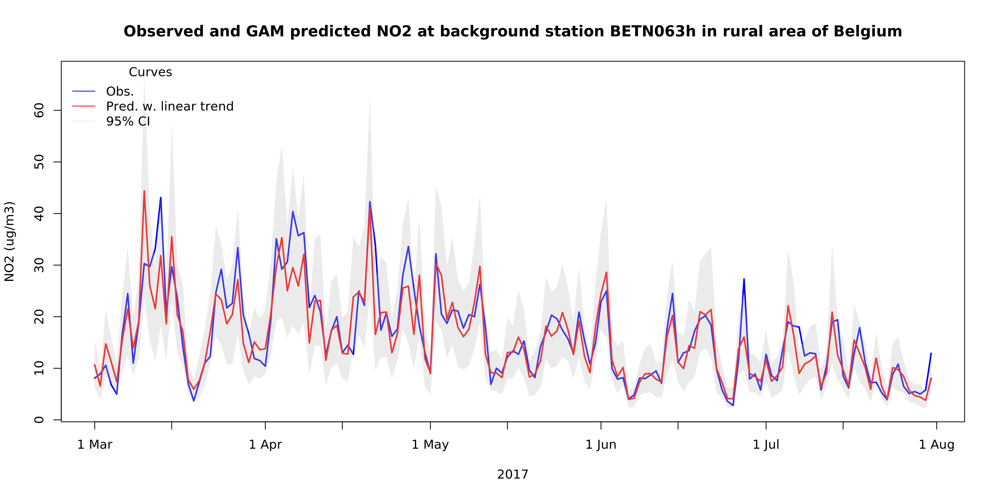
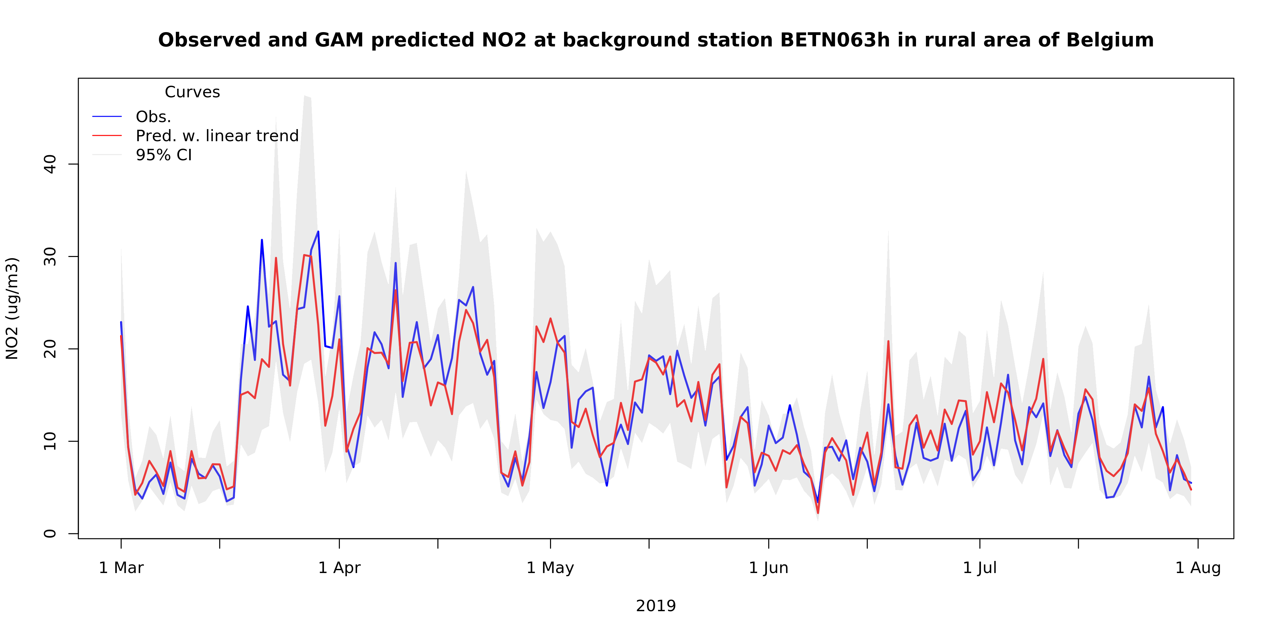
GAM performance – some examples

Slide 9
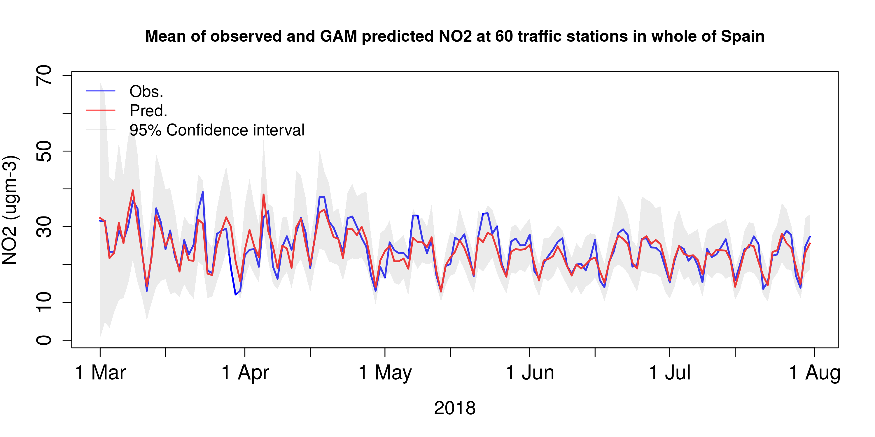
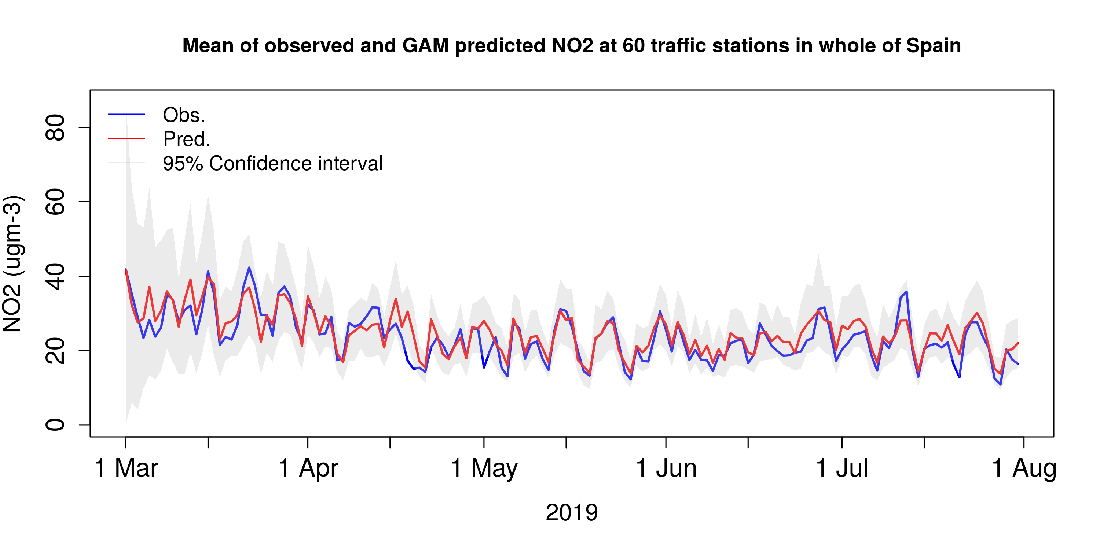
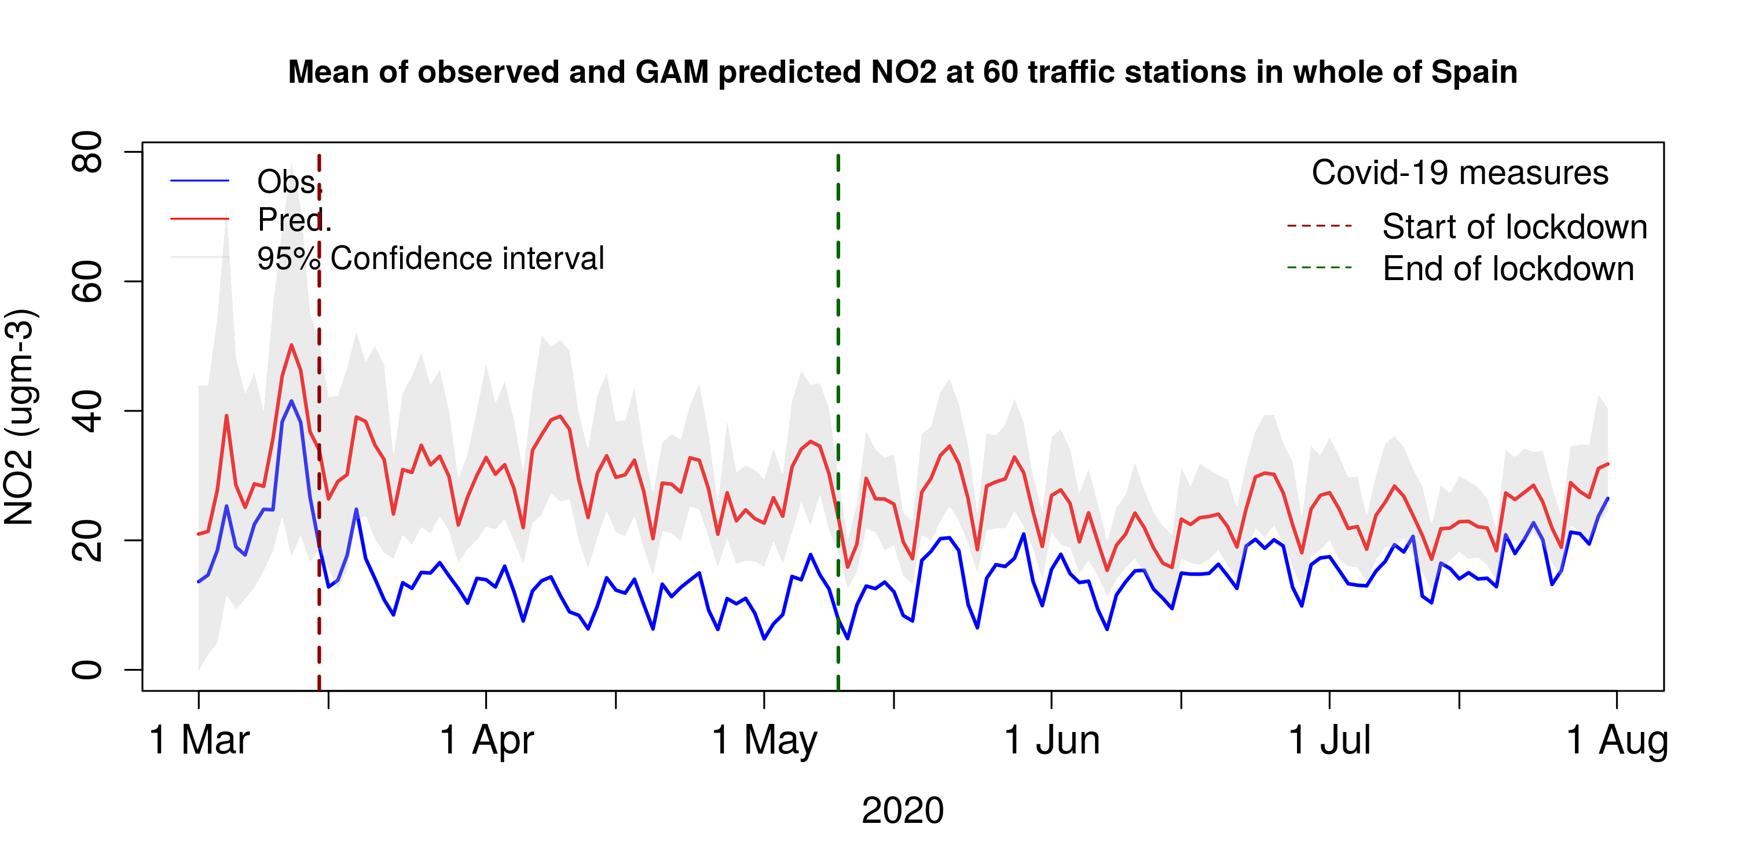
GAM results Spain

Slide 10
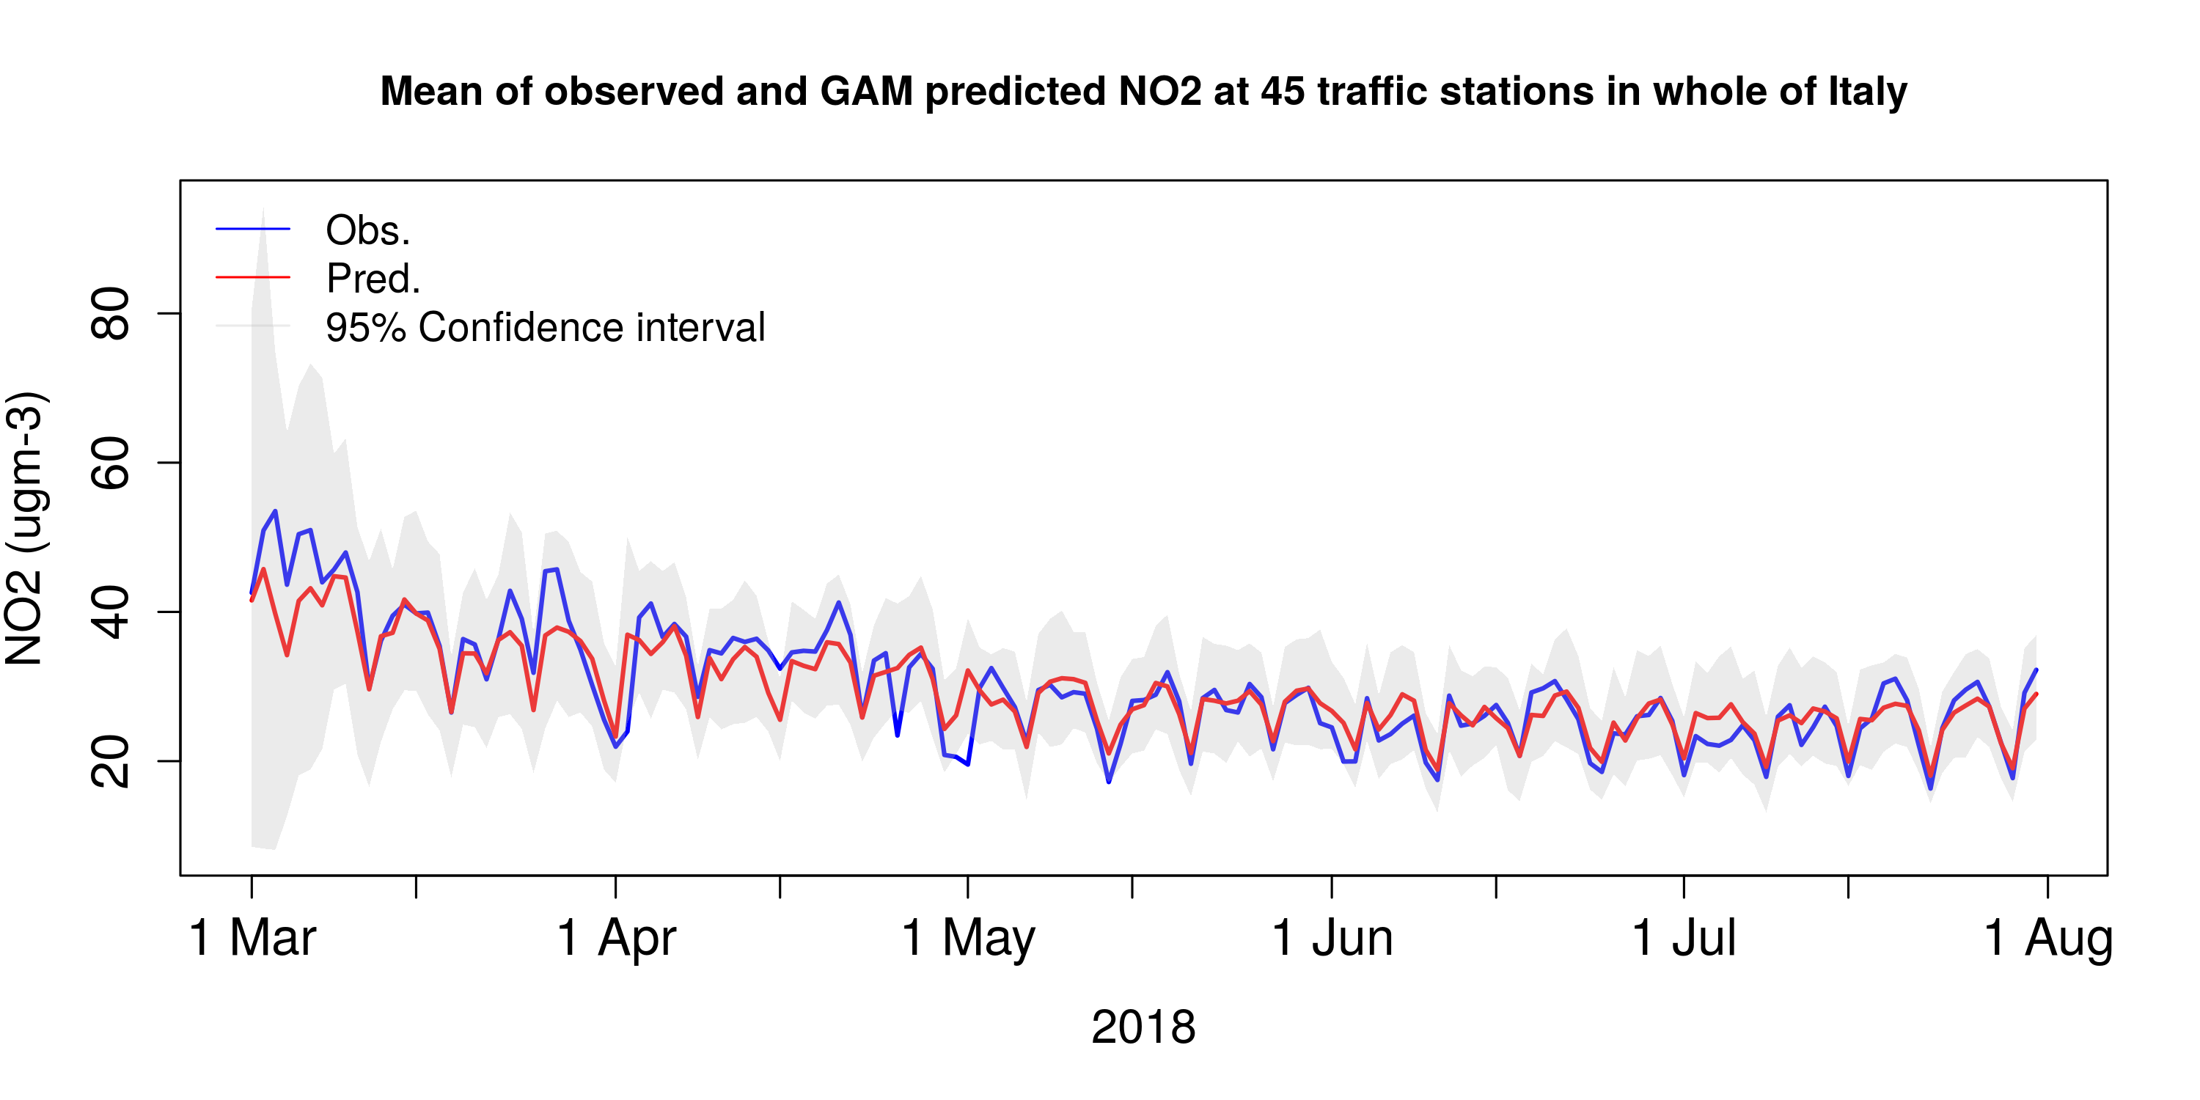
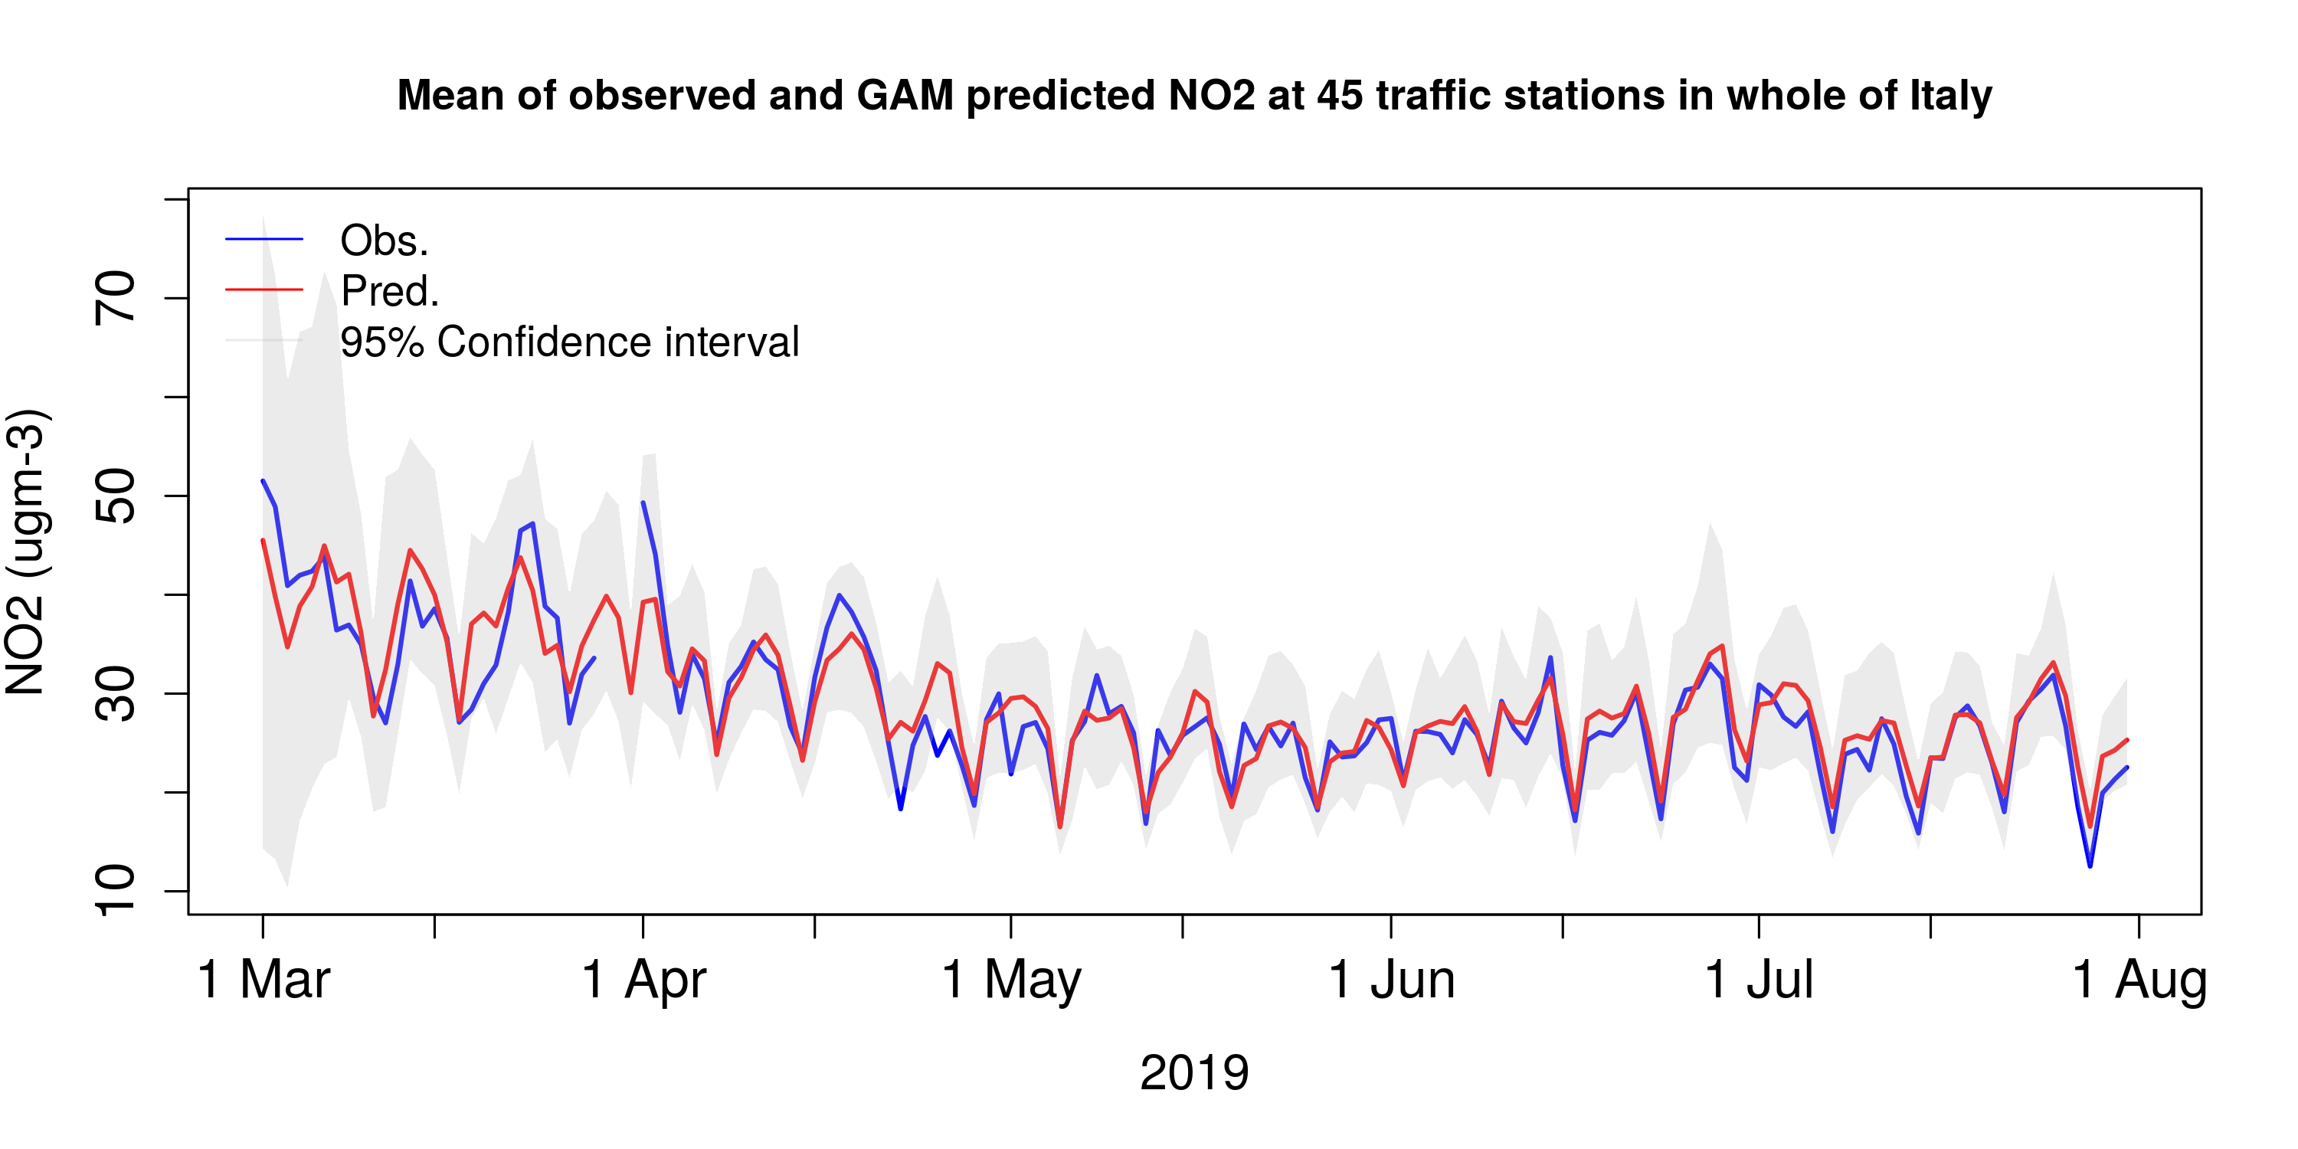
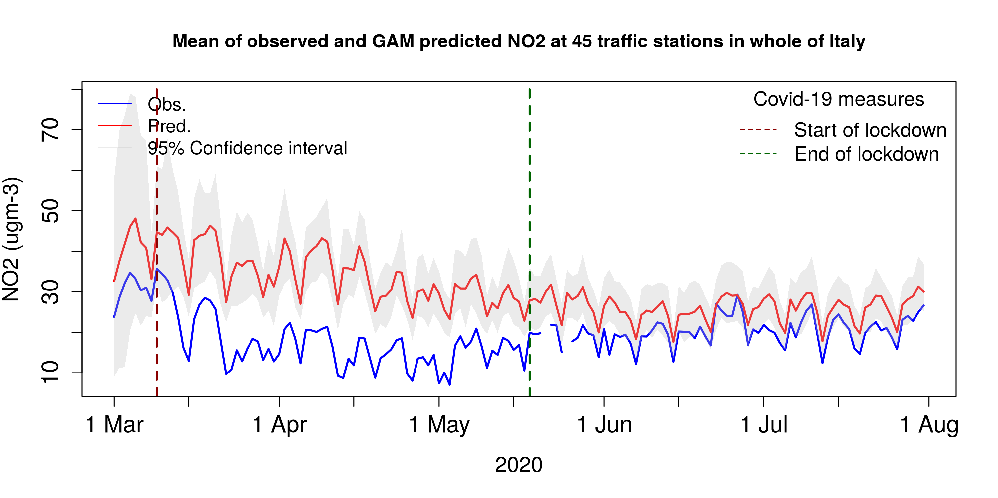
GAM results Italy

Slide 11
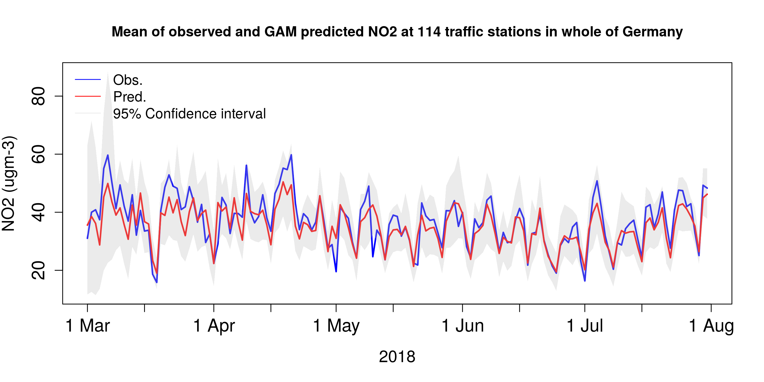
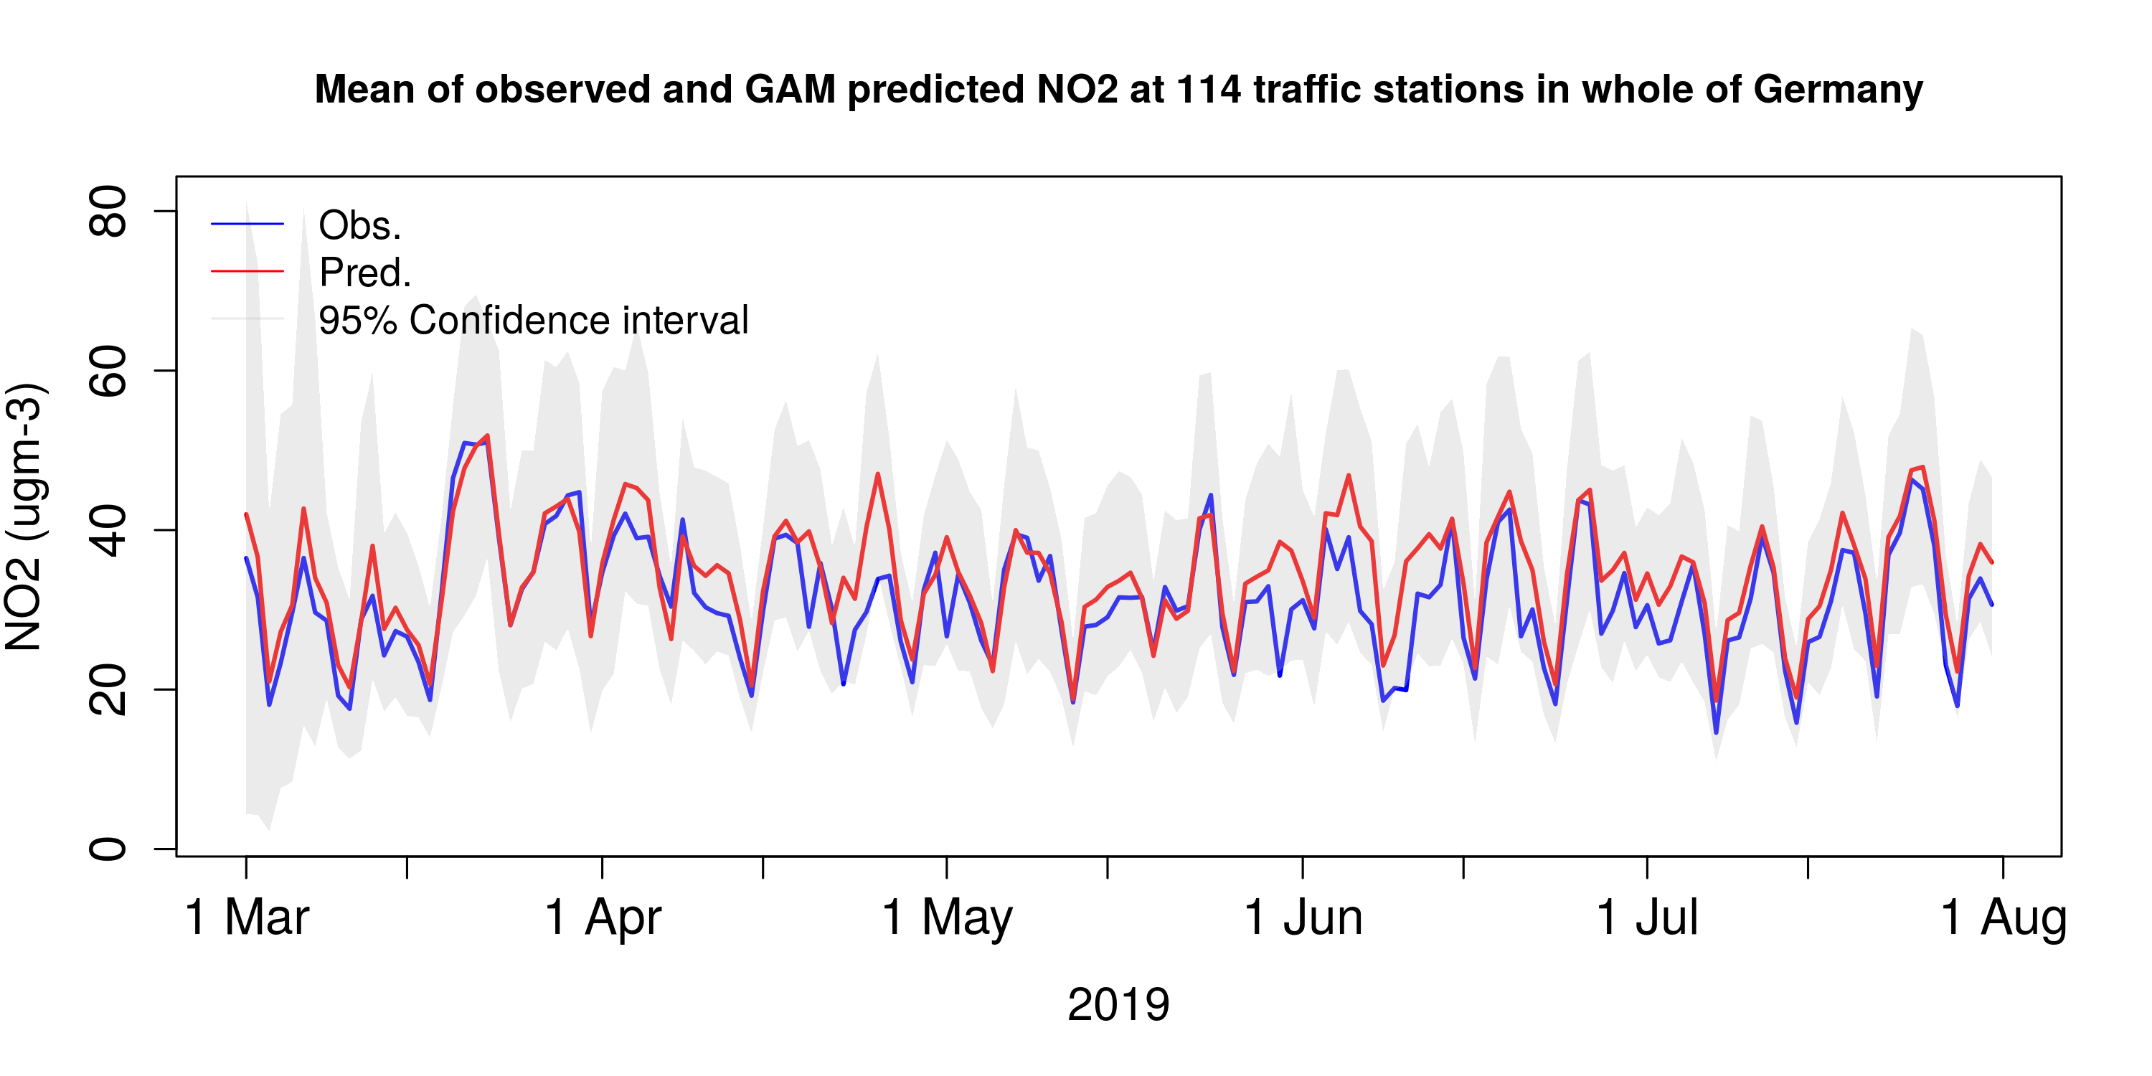
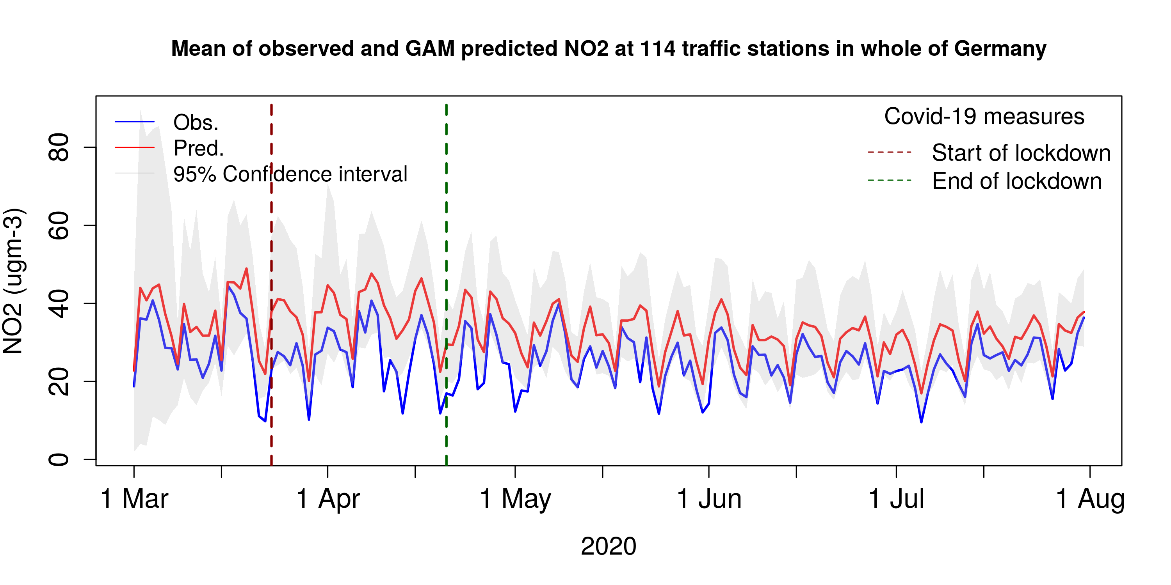
GAM results Germany

Slide 12
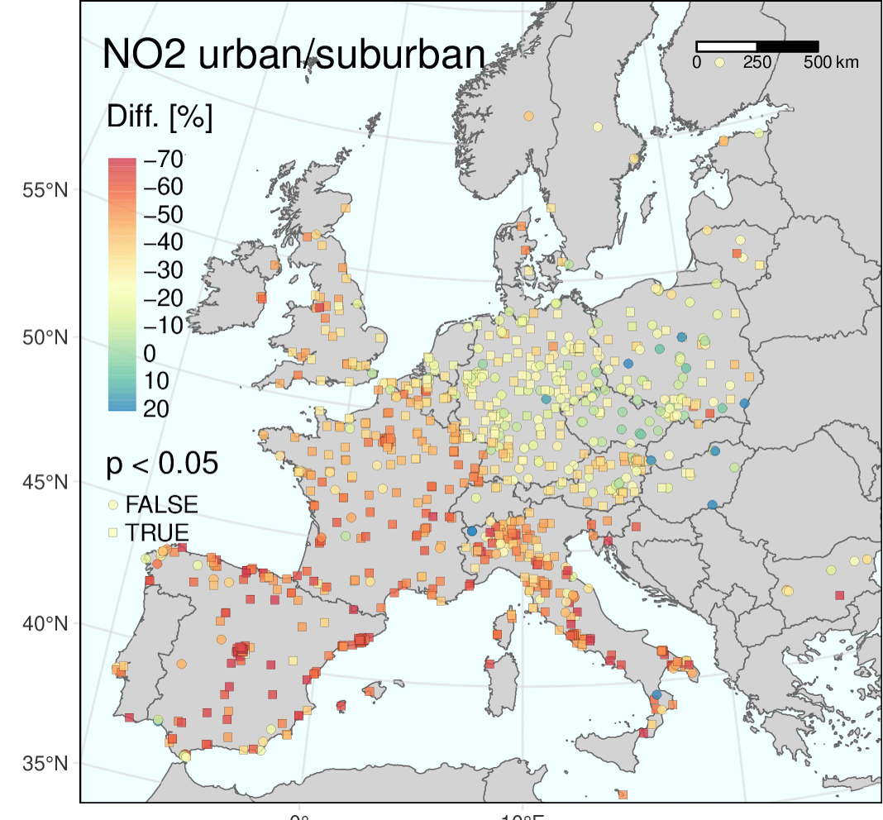
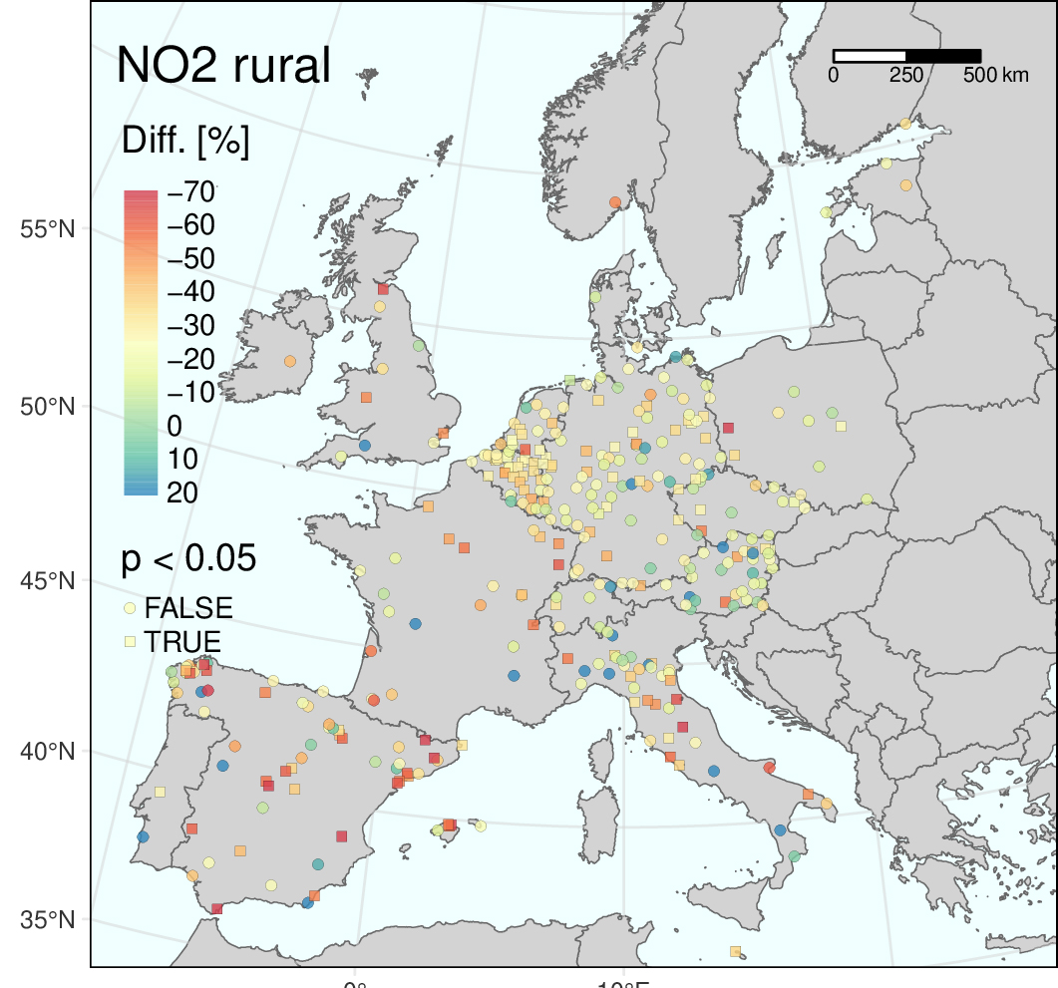
Changes in NO₂ concentrations due to lockdown

Slide 13
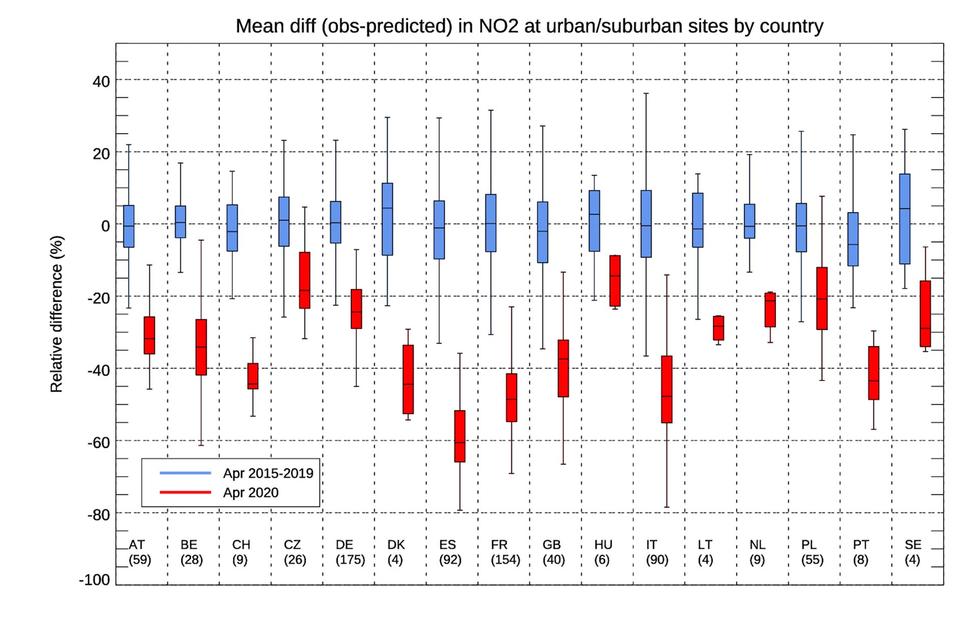
Changes in NO₂ concentrations due to lockdown - countries

Slide 14
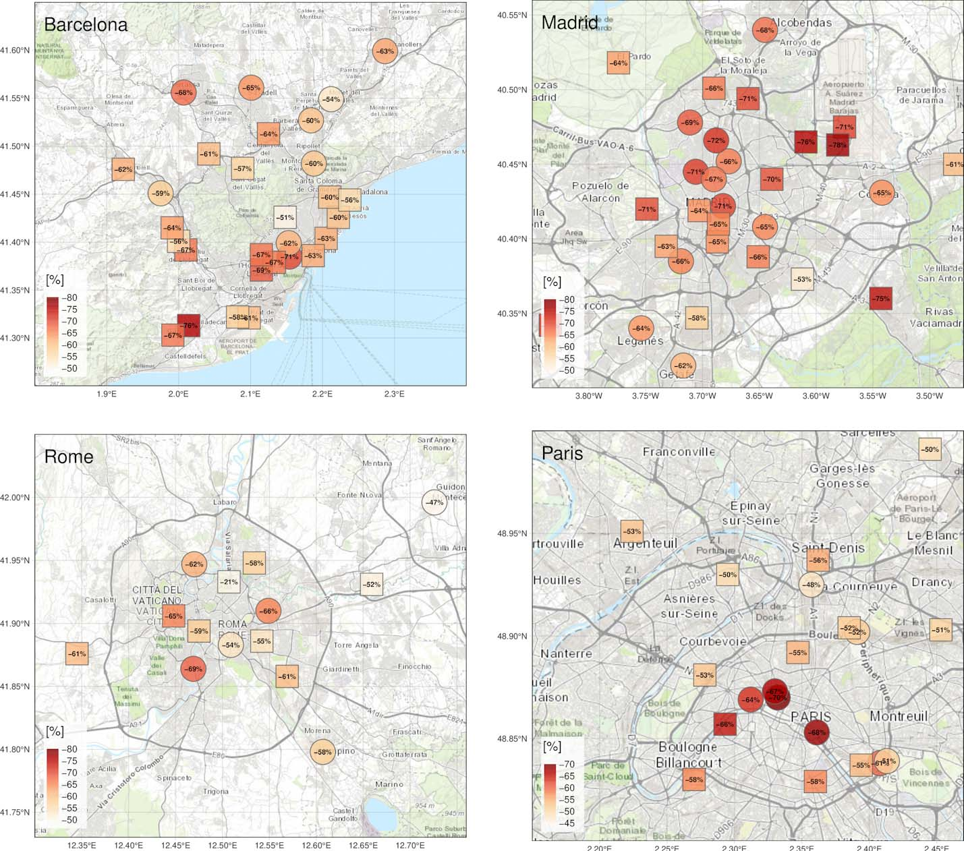
Changes in NO₂ concentrations due to lockdown - cities

Slide 15
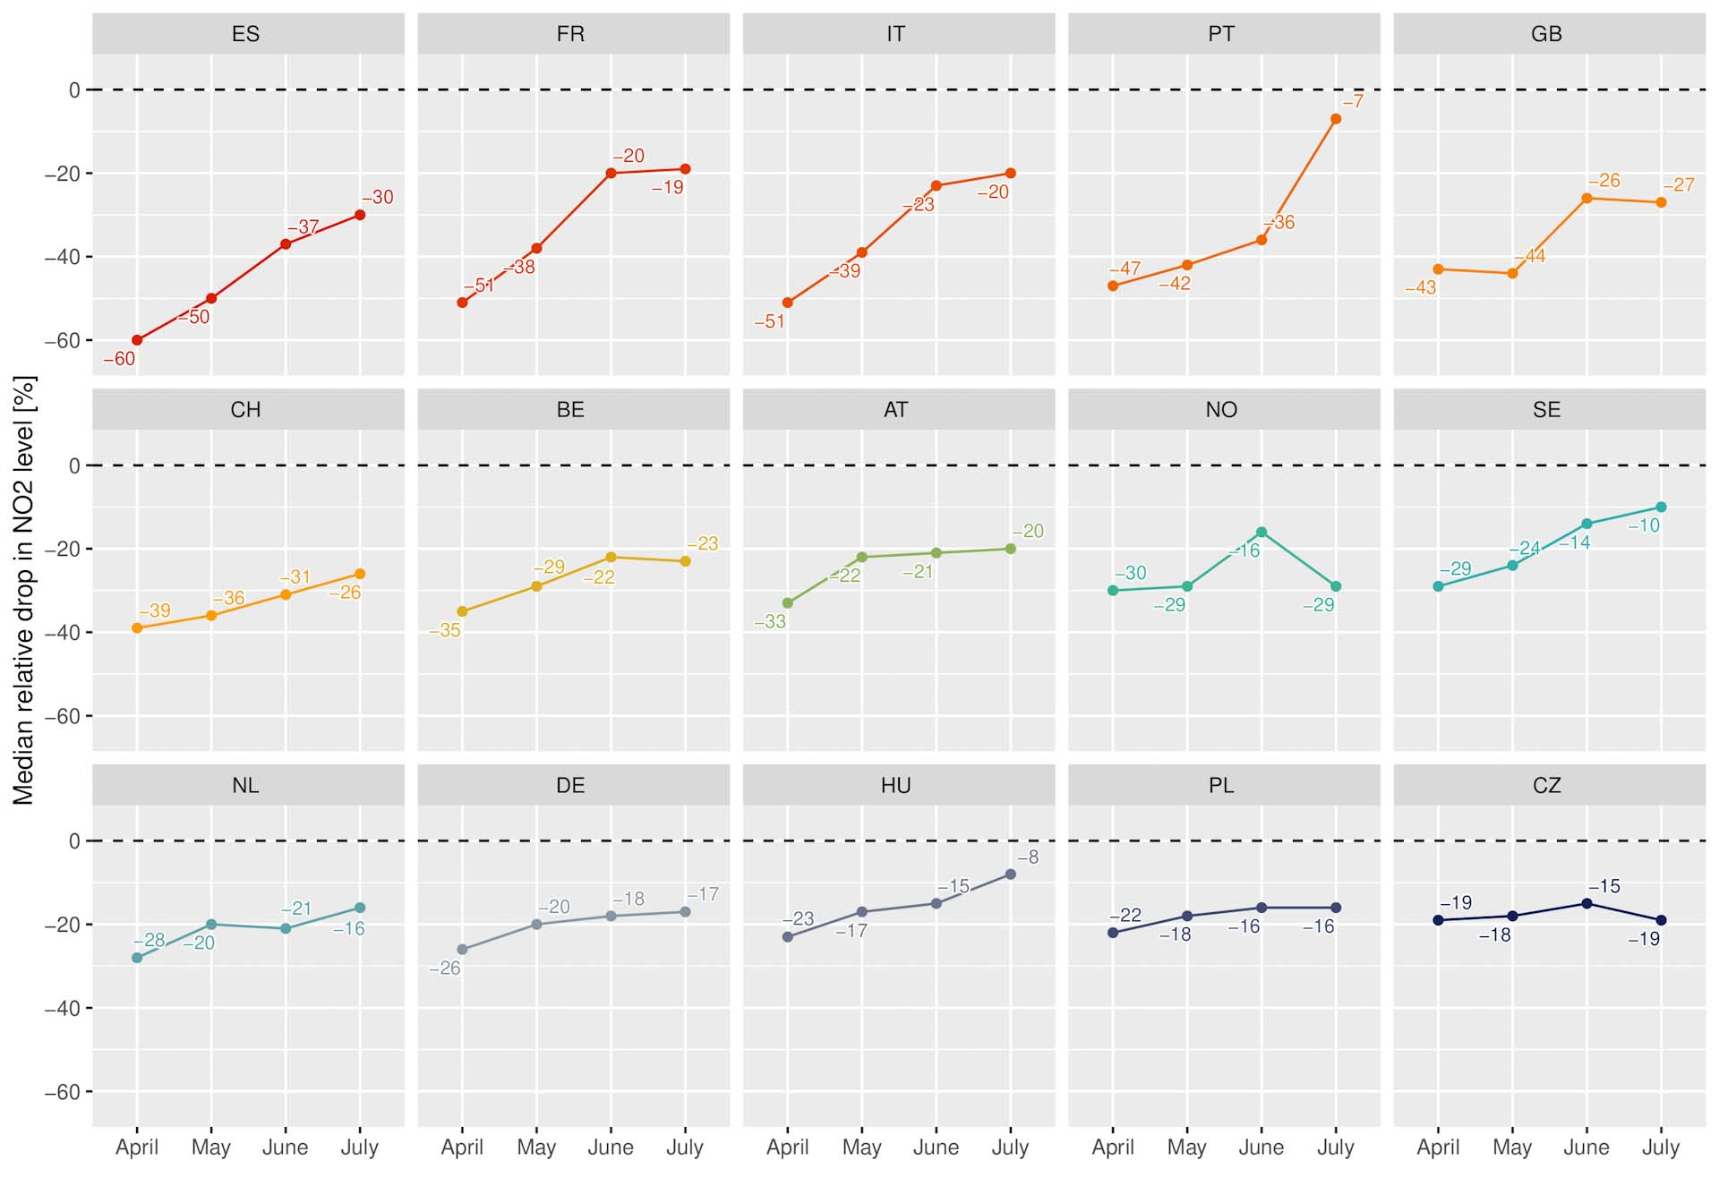
Recovery of NO₂ after lockdown

Slide 16
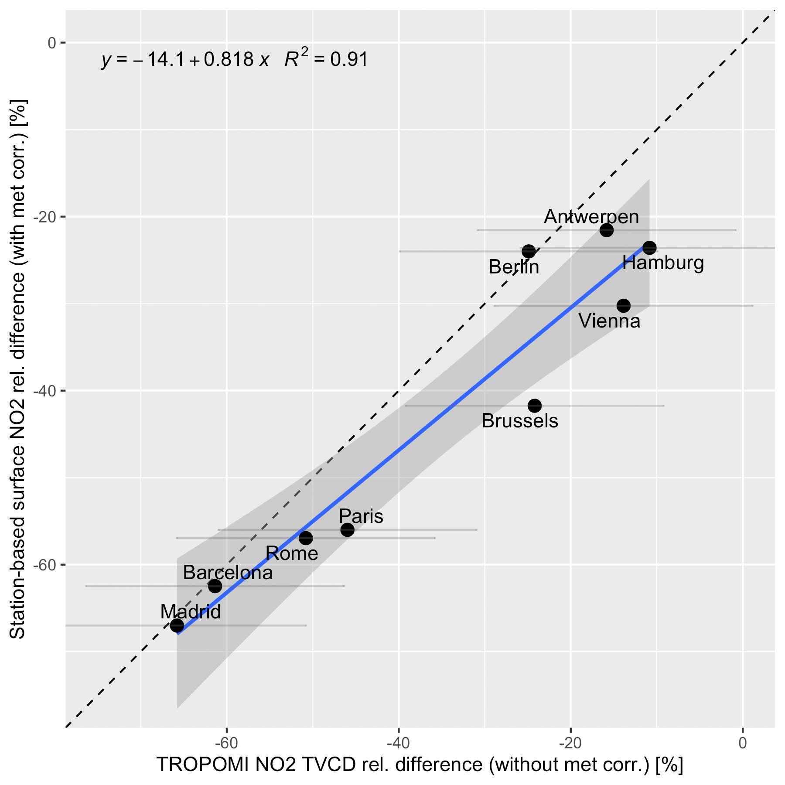
GAM reductions vs differences (2020 vs 2019) measured by the TROPOMI instrument on the Sentinel-5 satellite

Slide 17
Summary
The variability of meteorology must be considered in order to analyze reductions in concentrations due to lockdown
NO₂ concentrations have been greatly reduced due to reduced traffic during lockdown everywhere in Europe
The variations are large between countries, cities and stations
Strongest reductions in Spain, Italy, France and Great Britain (40-60 % in April)
Least reductions in the east (Hungary, Czech Rep., Poland) with < 20 % change
GAM model very well fit for the purpose

Slide 18

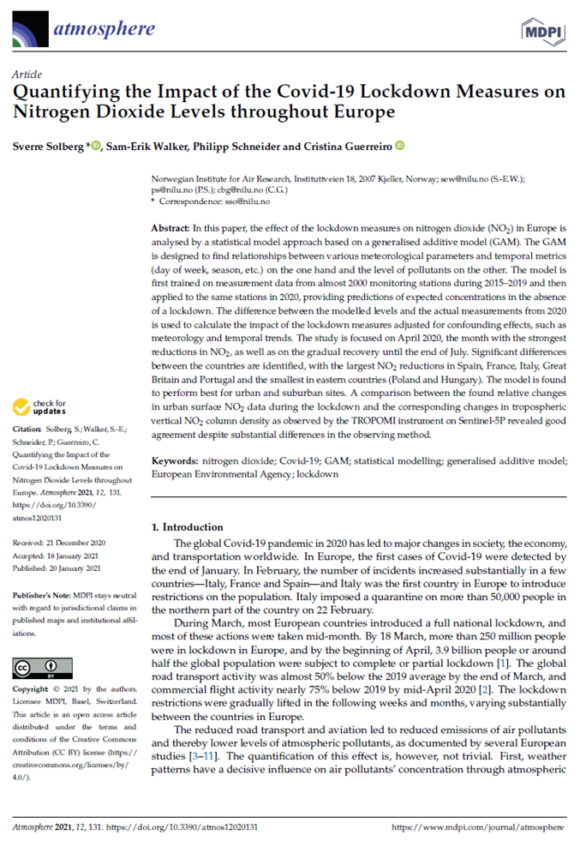
Publications of “the AirGAM model”
GMD documentation paper in prep. (Walker et al. 2021)

Slide 19
Thanks for your attention sso@nilu.no

